Slide 1

Integrated analytics with Azure Syanpse
Capstone Project
A Cloud For Modern Businesses
Analysis by –
TIPU RAJ
(Data Engineer Aspirant)
Skills- MS Azure, SQL, Python

Slide 2
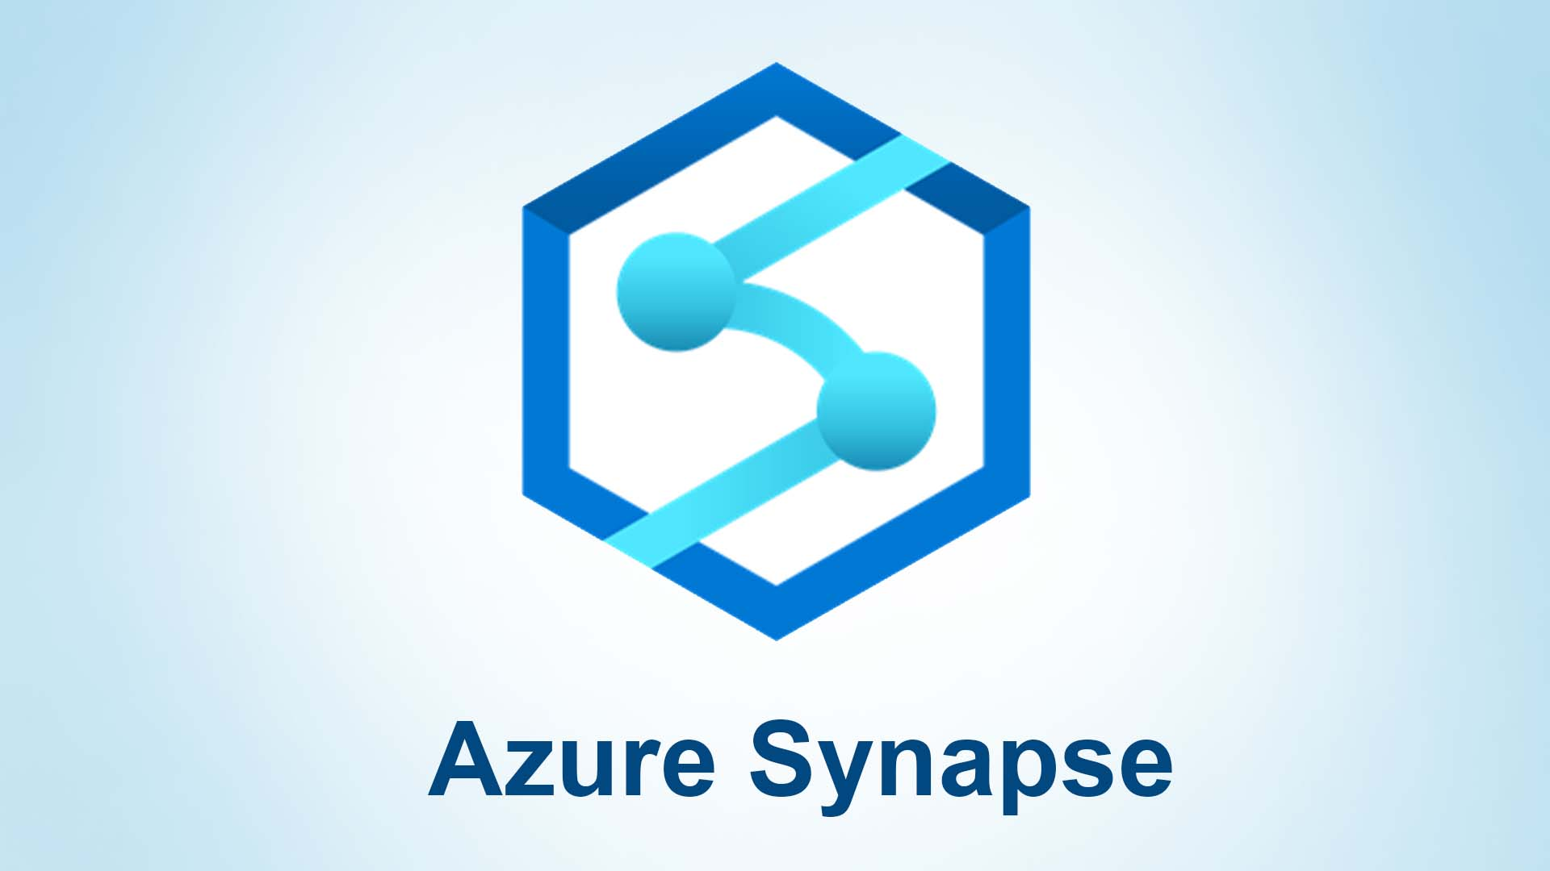



Introduction
Azure Synapse is one stop shop workspace that includes all the features of the Data Factory(ADF), Databricks, even we can Monitor our work that gives an edge over all other Resources. Azure syapse provides the code free environment to overcome the complexity for coding, also it provides very efficient integration with other resources like SQL databases, Spark pools with higher scalability with reasonable pricing tiers and consumption base model.

Slide 3

AIM OF THE PROJECT
To ingest the Data from the source to the Data lake storage.
Monitor the Pipeline during ingestion of the data.
To Create the SQL pool & Spark Pool in the Synapse Workspace.
To transform the data & Analyse the data by performing Queries using SQL & Spark Pool.
Visualize the result set using in-built Chart function with necessary changes.

Slide 4

prerequisites
Microsoft Azure account.
Resource Group.
ADLs Gen 2 storage.
Synapse workspace.

Slide 5



Problem Statement-I
Ingest the data into the ADLs Gen 2 account from a URL by using Azure synapse Workspace.
Source Dataset url : https://raw.githubusercontent.com/MicrosoftLearning/DP-900T00A-Azure-Data-Fundamentals/master/Azure-Synapse/products.csv

Slide 6
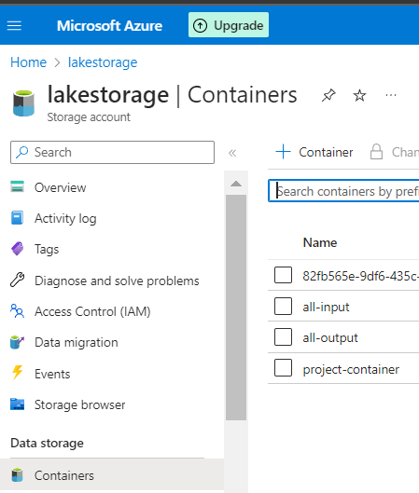
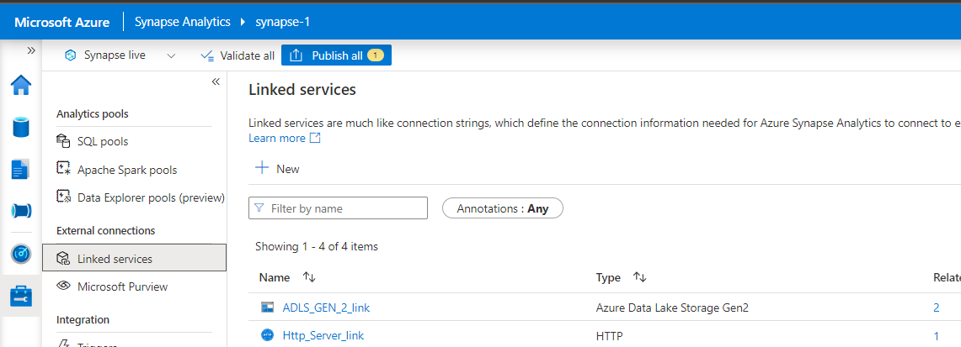
Table
ADLs GEN 2 / Data Lake:-
Linked Services:-
I have created the linked services under the manage for the ADLs gen 2 which will connect the source and sink location to extract the data
This storage account has a container named project-container where i need to copy our source data from url to do further analysis.
Created the link service for the HTTP option in the dataset to extract the URL data from the source location

Slide 7
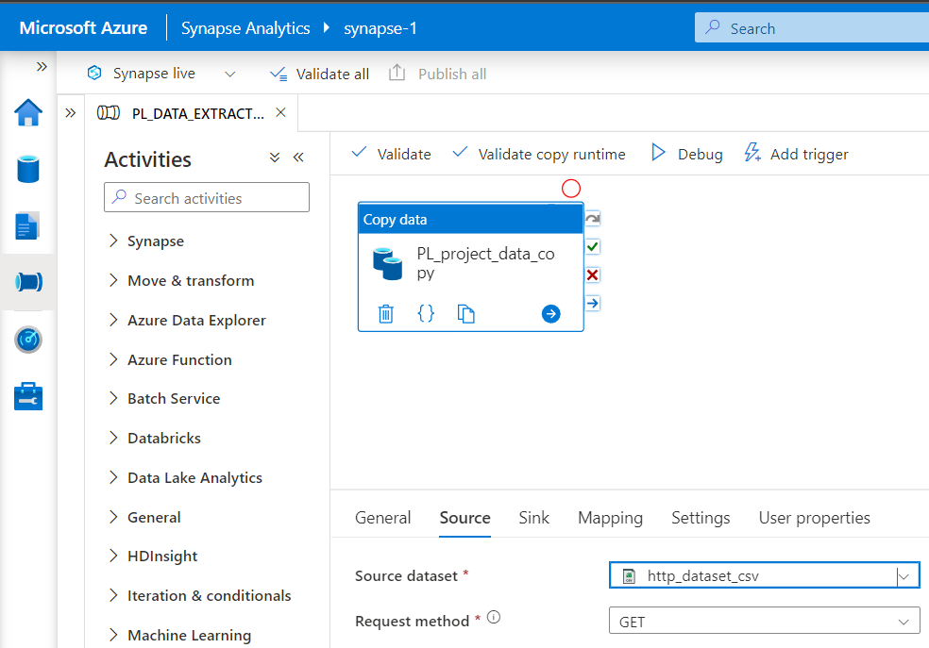
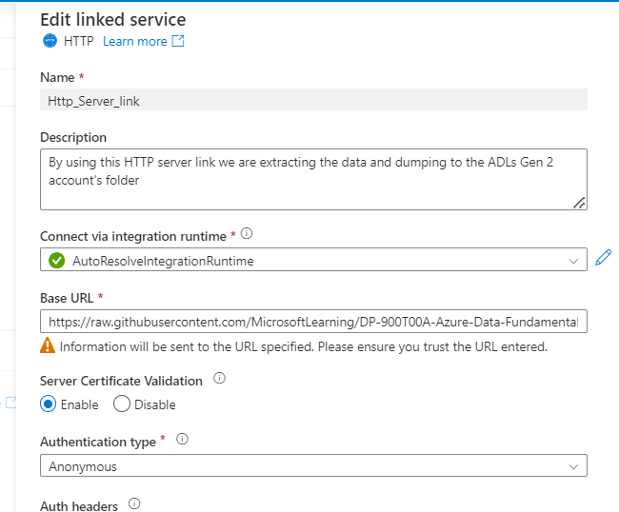
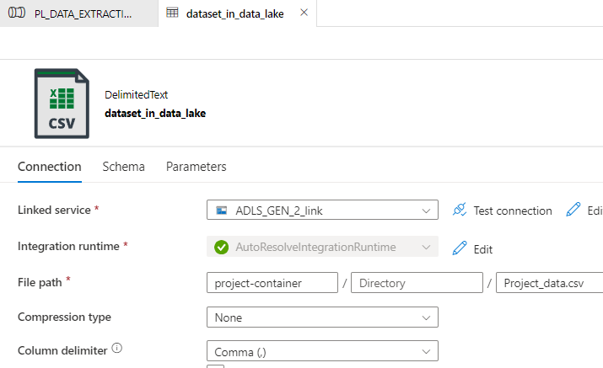
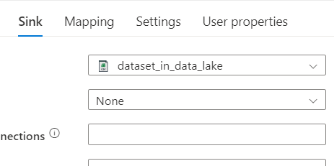
Defining the pipeline to Copy the Data into the source location as per the Question asked.
1.Validate the pipeline
2.Publish all
3.Debug then trigger the pipeline
HTTP link service for dataset
Source data url
To ingest the data in the Piepeline
Storage link service
Storage file path
In the container
With file name:-
Project_data.csv
Choosing the copy data from the activity under pipeline .

Slide 8
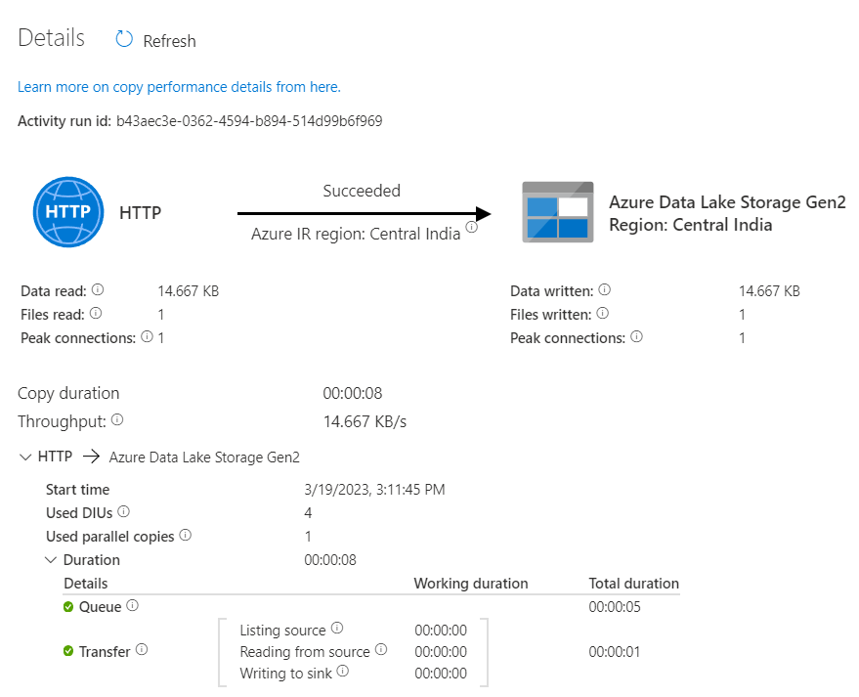
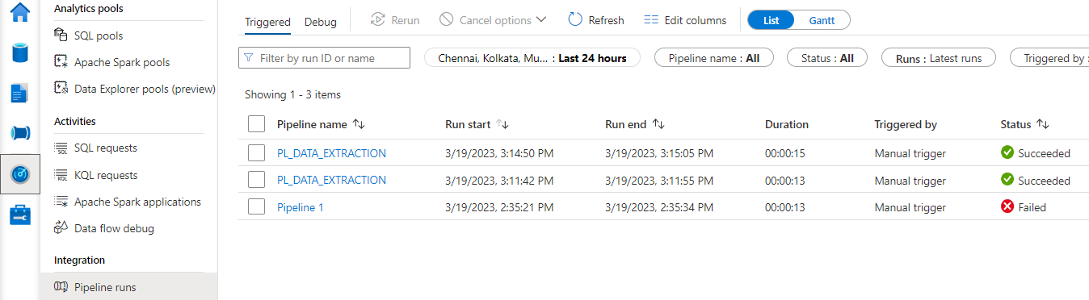
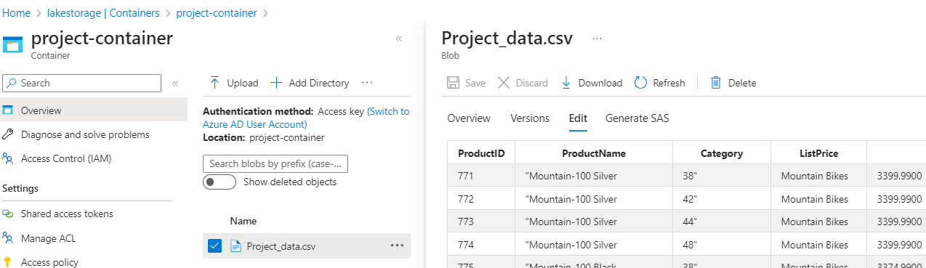
After Triggering we need to go to the monitor and check the pipeline whether it throw any error or not. In my case there was a connection error.
After fixing it, I ran it for the second time and it got executed Successfully.
Now i checked the Storage for CSV ingested data.
In containers which i have selected as the sink destination.
I have successfully ingested the data

Slide 9
Problem Statement-II
Explore Data hub, find your file name on the page you will find xyz.csv files.
Analyze and query the data that has been ingested in the Azure Synapse workspace where we can verify with SQL code.
There will be an issue with the result it shows the column name as c1, c2, c3 and c4 .
Fix this in the code. Now you need the update the query by selecting the category and count as Product_Numbers (any name of your choice).
Once the updating is done then save the code.
Reopen it and run again to access the number of total products.
From result select chart view to Visualize the result make necessary changes to it.

Slide 10
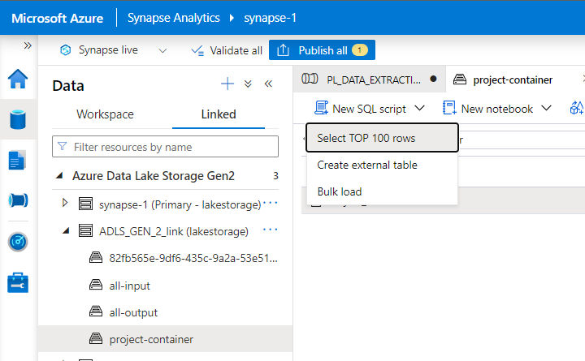
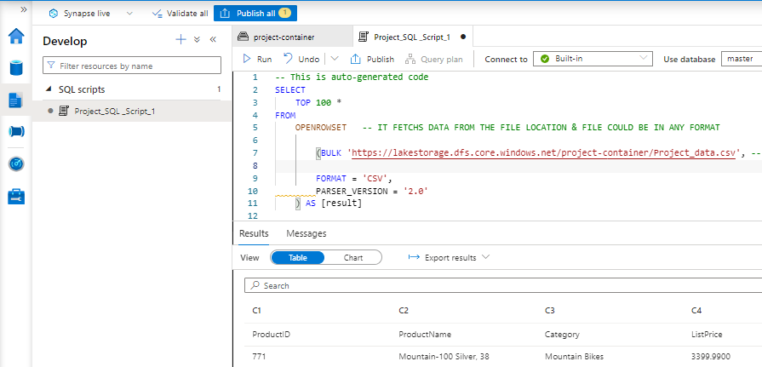
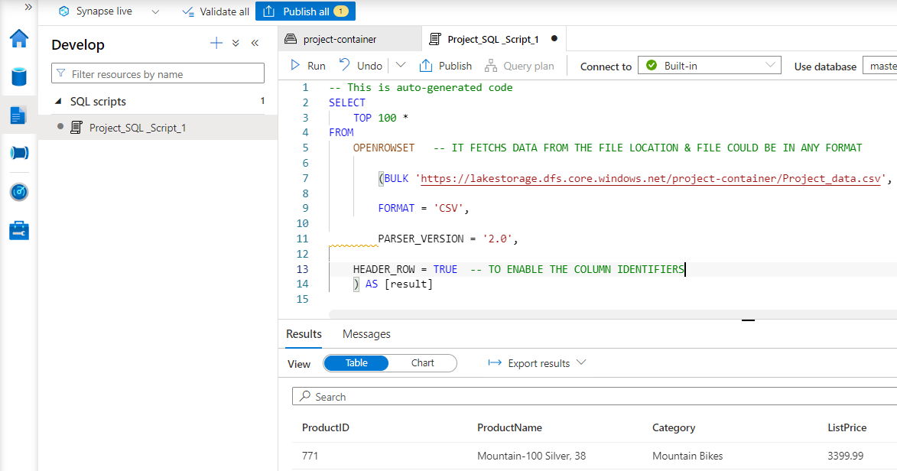
=>>> Approach.
Open the synapse workspace > click on the data hub > navigated to the container which has the csv file.
Clicked on the SQL script and selected Top 100 rows option and sun with IN-BUILT SQL Pool.
It gave me this output with the Alpha-numeric headers.
Alpha-numeric header
Need to change it.
To change the Header,
In the Query i need to define the Header_row = true
Now the headers changed according to the dataset.

Slide 11
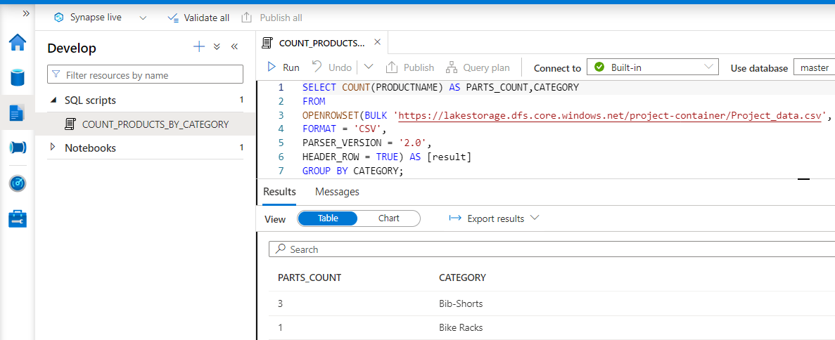
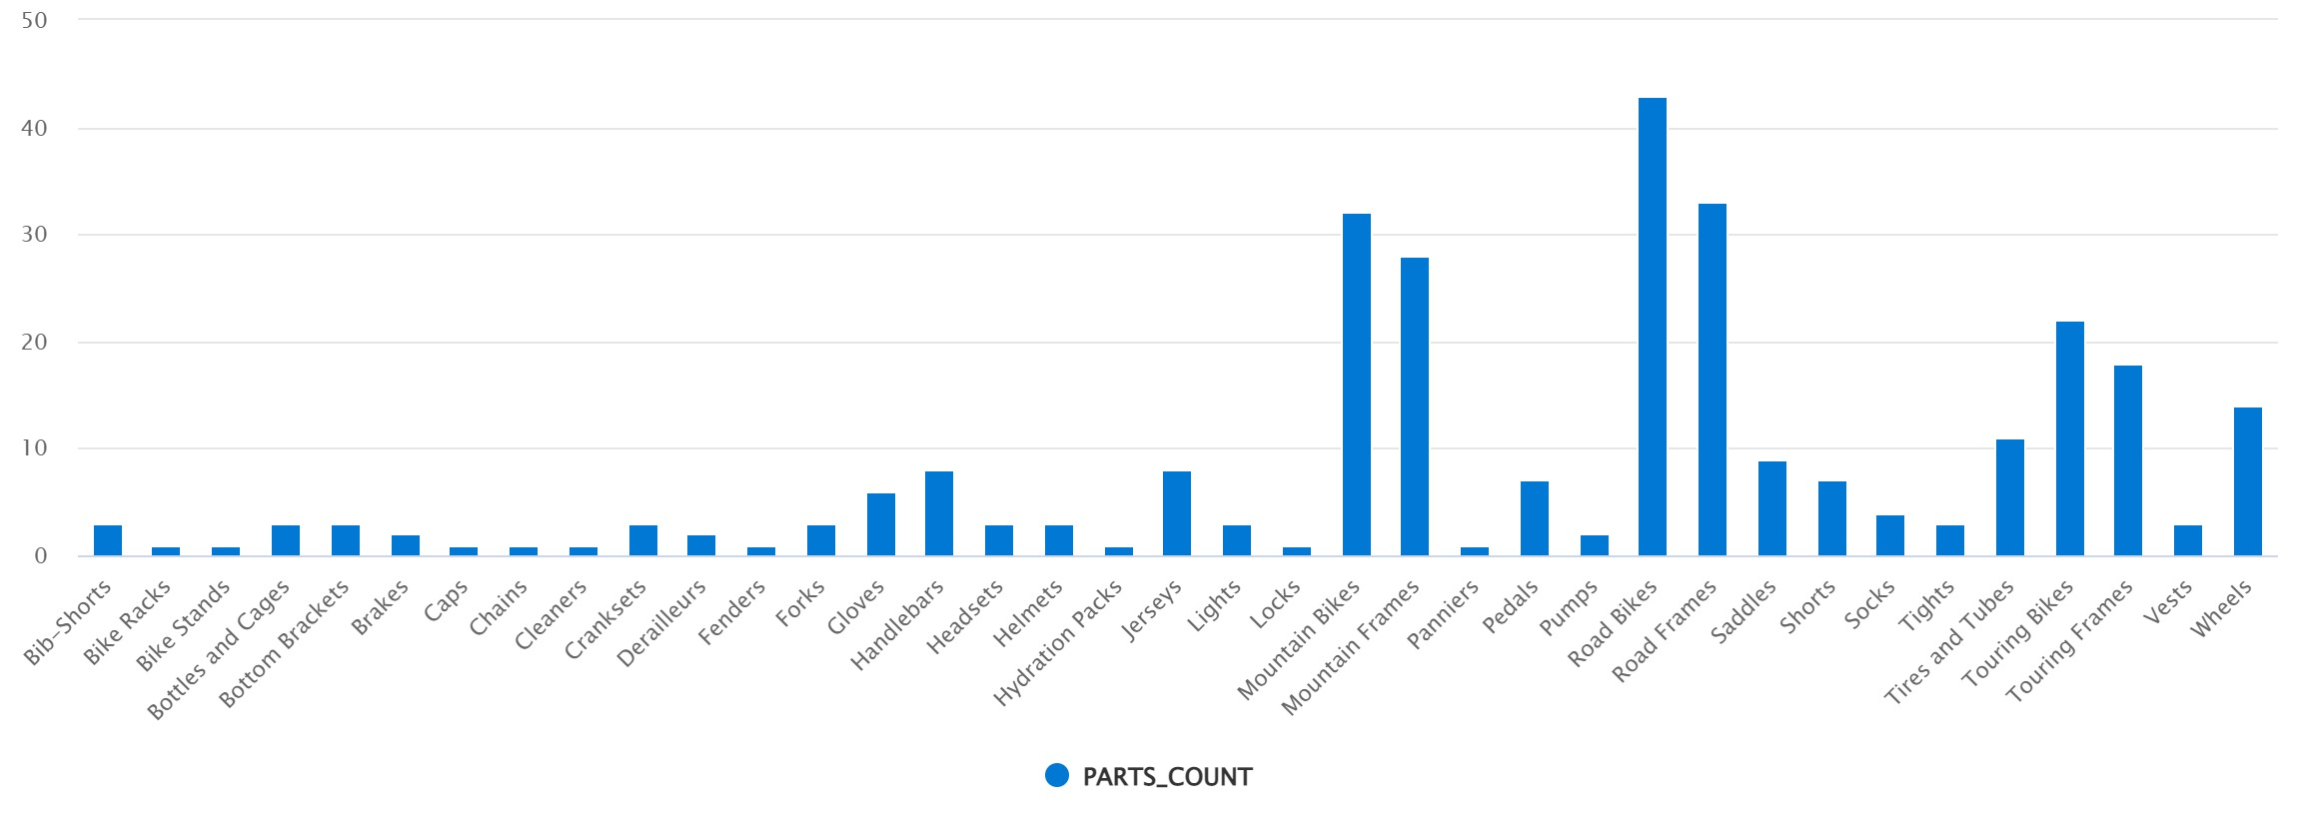
Now as per the question, I have created a new SQL script and with serverless SQL pool and I have done some analysis with by using the query to find the count of Product_Name Column and grouped it by each element in category column. After getting the result I have Pubished it and it get saved by the name which I have given to the script.
Published in develop as count_products_by_category
As per the question I have selected the chart view in the queried results and given predefined parameter so I got this output.
Parts_cout vs category
Visualization.

Slide 12
Problem Statement-III
Analyze the data using the Spark pool as we all know SQL is common query language for structured datasets and there are languages like python which is effectively used for data analysis.
Create the Spark Pool.
Need to Perform same task what we have done into the SQL Pool.
Save the Notebook.
From the result we need to visualize the analysis in spark environment.
Haults and Difficulties
After creating the Spark pool I was unable to run my queries. The error message was in the Vcore sizes. So I tired different scaling sequence to create the sparkpool and after somes references and doing it for multiple times it got runned successfully.

Slide 13
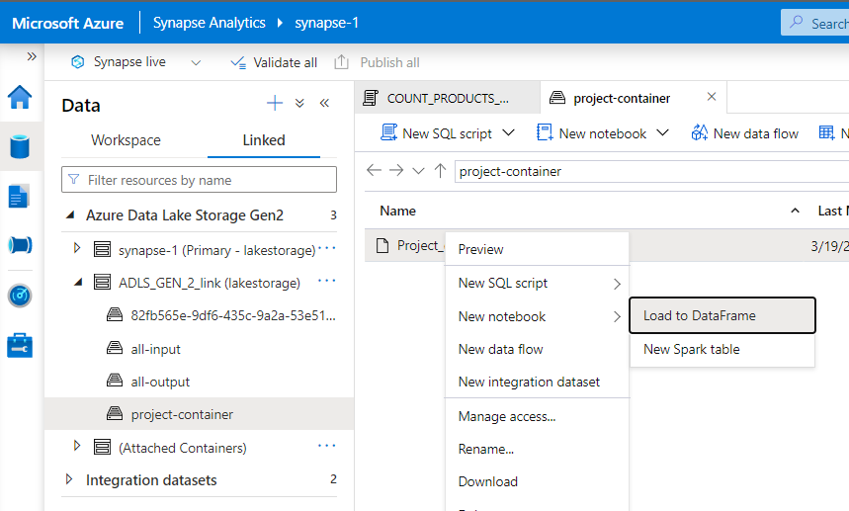
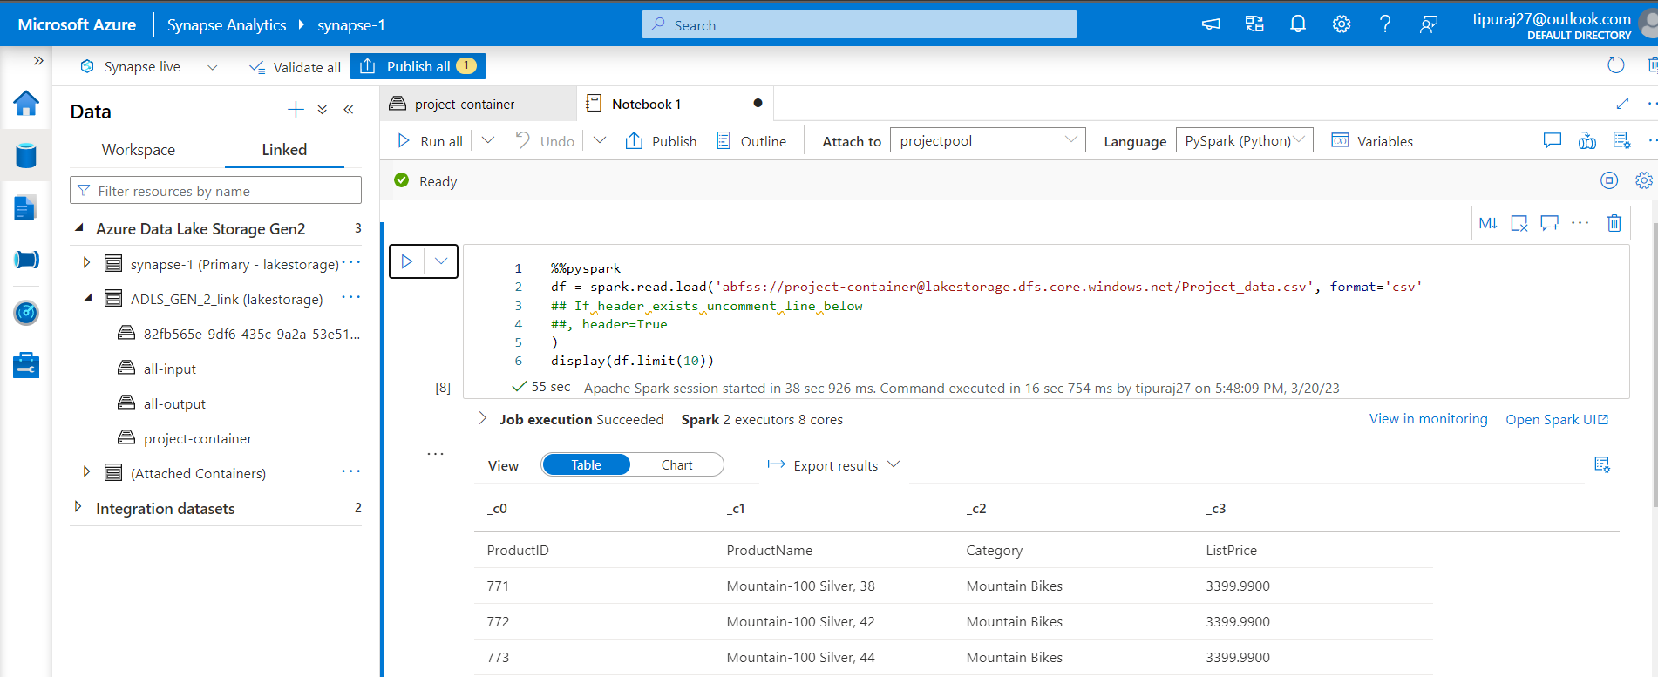
=>>> Approach.
Open the synapse workspace > Created a Spark-Pool > click on the data hub > navigated to the container which has the csv file.
Clicked on the New Notebook > Load to Dataframe > Run the query with the Spark pool which I have created.
Now here also I got alpha numeric and we need to make the header True.
Note: At First Spark tool will take some time to start and second will take less time to execute and the pool is already ready.
Alpha_numeric
header
As For now I Need to set the header = True, so in the query i removed the # # marks from it and run the query again. It will give the desire output and then i published that to the workspace and notebook got saved under the develop.

Slide 14
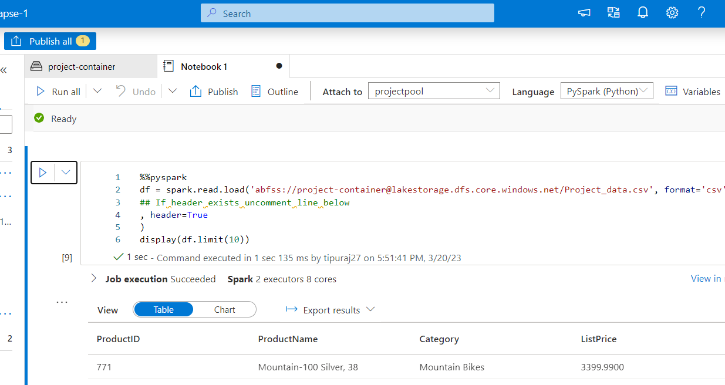
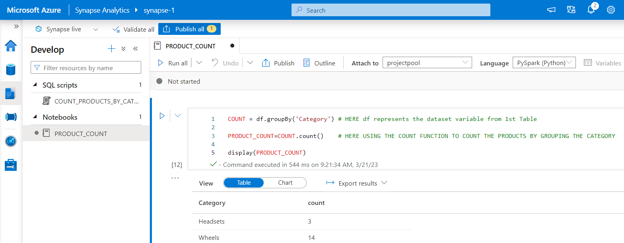
Now the header is according to the CSV file itself.
According to the question I need to count the productName and categorise it by the category column

Slide 15
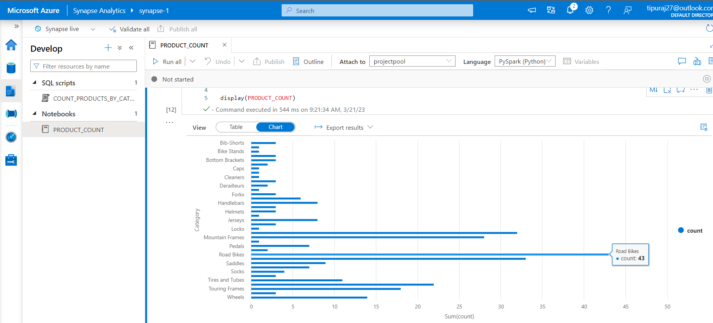
As Per question asked I created a visualization chart from the Result set in spark pool from the csv data.
Published Notebook got saved under the develop by Product_count name.
Visualization
THANK YOU

